Slide 1
The Problem Statement
Best Movie’s which gain popularity on the basis of the segment are Genre, Revenue and
Budget .

Slide 2
The Ghost Deck
Synthesis:
The revenue,genre,Budget are few segment which decide the Performance of movie.
Overview Of Analysis:
Dependency of revenue
Role of Genre.
Importance of Budget
Revenue Differences:
Revenue difference of the movie’s according their respective Genre. Which is used to be find out ?
Type of Genre:
Which type of genre movie
carry should be factor of popularity in different age groups ?
Budget:
Budget is also an important factor which help to bring good quality movie and make’s attractive.
Limitation 1:
The dataset which is Provided is unclean. To find the genre we used to be split the columns .
Limitation 2:
Some Where the value’s of budget and revenue are null which result to be in a wrong answer
Review of Next Step:
Trailer‘s are the best way show the Glimps of the movie and create curiosity.

Slide 3
Executive Summary:
The Movie’s perform well or run successfully when their revenue is high and popularity should also be there.High revenue is there when the budget of movie is less and box office collection is greater than budget of the movie.Genre also help the movie to gain the popularity.Like youth likes Action movies.By these three parameter we reached to our goal to find out popular movies.

Slide 4
Hypothesized biases and limitations:
To increase the revenue movie’s should carry Good Budget which would result in a good revenue.
Genres should be well chosen according to the age group of the population.
Limitation are like Provided dataset is not unclean and having lot of bad data .In genre we used to split the column before used in analysis.
Limitation are like Provided dataset also having some missing values in revenue’s and budget columns. which result in wrong analysis.

Slide 5
Analysis:
In this Movie Dataset we used to be found movie on the given parameter like revenue ,budget, genre and popularity. So we have to build some visualization in between in these parameter which help us to reach the goal like we have builds some relationship visualization in between Title of movie and the revenue. That come’s out be very useful. we also use comparison visualization which help us to find the best movie in between the data of two top movie’s. we can also use distribution visualization to find the performance of particular genre over the years. That how we performed visualization. Next is how we manage the limitation in Dataset like missingness which is the biggest problem in this data set like to use genre in visualization we use to perform critical splitting of column. Some movies have missing budget and some have missing revenue which create a missingness called missing at random. Homepage column is completely null which give missing completely at random type of missingness. After normalization of the dataset by performing listwise and pairwise deletion. we perform visualization actions which gives us results. But errors are still there in our result because we perform some cleaning operation on the dataset. That how we analyse the dataset and whole activities we used to perform on given dataset.

Slide 6
Biases In Dataset:
In the given dataset we find out some movie having two genre which lead to to the selection Bias if we go dipper then there is also voluntary Bias is there in which data is voluntary selected from the data collection.
Here the revenue is also undercover bias which is used to be depend on the budget and performance of movie and lot of other factor.
Popularity of the movie also is undercover bias which depend on lot of factor revenue,Budget and the performance of the movie.

Slide 7
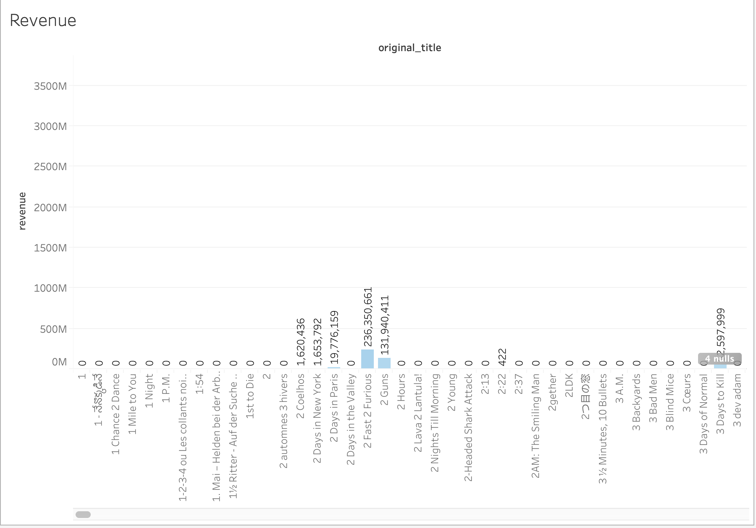
Visualization for revenue
Here we can see that lot of the movies title carry 0 revenue which is impossible this is due to missingness at random. Which is an limitation .So we have to perform normalization activity called listwise deletion and pairwise deletion.

Slide 8
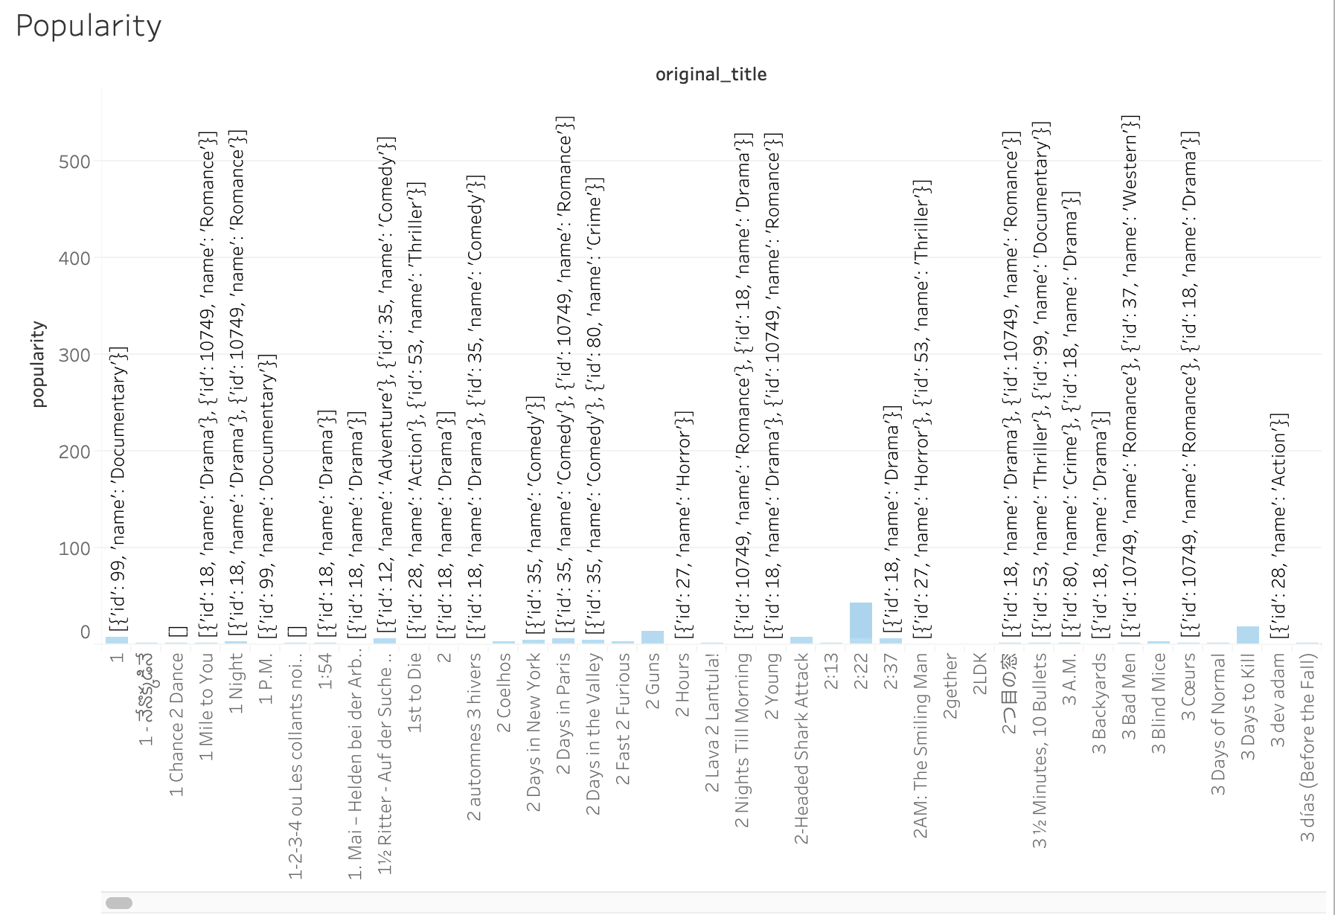
Visualization for popularity
Now here we can see that we can,t able to use genre without performing some cleaning action Like splitting the column. It is a kind of limitation Which create problem visualization activity
related genre.

Slide 9
Thank you

